Slide 1
AVL Tree

Slide 2
Problem with Binary search tree
The disadvantage of a binary search tree is that its height can be as large as N-1
This means that the time needed to perform insertion and deletion and many other operations can be N times in the worst case
We want a tree with small height
A binary tree with N node has height at least log₂ ( N+1)-1
Thus, our goal is to keep the height of a binary search tree log₂ ( N) times
Such trees are called balanced binary search trees. Examples are AVL tree, red-black tree.

Slide 3
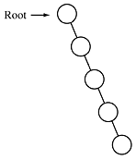
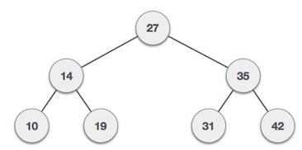
Binary search tree
balanced Tree
Unbalanced Tree

Slide 4
AVL
There is a need to maintain the binary search tree to be of balanced height, so that it is possible to obtain for the search option of log₂ ( N) time in the worst case.
One of the most popular balanced tree was introduced by Adelson velskii and landis (AVL)

Slide 5
AVL Tree
An empty binary search tree is an AVL tree
A non empty binary tree T is an AVL tree iff T^{L} (left subtree) and T^{R} (right subtree ) of T and h(T^{L} ) (height of left subtree) and h( T^{R} ) (height of right subtree ) where | h(T^{L} ) - h( T^{R} ) | <= 1
Balance factor BF is difference between h(T^{L} ) and h( T^{R} ) and the value will be -1 0 1
BF = h(T^{L} ) - h( T^{R} )
50
BF = 2-1 =1
T^{L}
T^{R}
h=3
h=2

Slide 6
5
Not AVL Tree
3
1
4
5
3
8
AVL Tree
1
4
10

Slide 7
Rotations
Left to left: Inserted node is in the left subtree of left subtree of node A
Right to right: Inserted node is in the right subtree of right subtree of node A
Right to left: Inserted node is in the right subtree of left subtree of node A
Left of right: Inserted node is in the left subtree of right subtree of node A
Trick to Solve
For LL and RR find A and B and make A as child of B
For LR and RL find A , B and C and make A, B as child of C

Slide 8
Insertion in left child of left subtree
Single Rotation
V
U
U
V
Z
X
Y
Z
Y
X
After Rotation
Before Rotation

Slide 9
5
5
U
8
8
Z
3
3
V
1
4
1
4
Y
AVL Tree
X
0.8
Insert 0.8
3
5
1
After Rotation
4
8
0.8

Slide 10
Double Rotation
Suppose, imbalance is due to an insertion in the left subtree of right child
Single Rotation does not work!
U
W
Before Rotation
After Rotation
V
V
U
D
W
A
A
C
D
B
B
C

Slide 11
5
U
5
D
V
8
3
3
8
1
4
A
1
4
W
AVL Tree
B
3.5
Insert 3.5
4
5
After Rotation
3
8
3.5
0.8

Slide 12
Extended Example
Insert 3,2,1,4,5,6,7, 16,15,14
3
2
3
3
2
1
Fig 1
2
3
Fig 4
Fig 2
2
1
2
Fig 3
1
1
3
3
Fig 5
Fig 6
4
4
5

Slide 13
2
2
1
4
1
4
3
5
3
5
Fig 8
Fig 7
6
4
4
2
5
2
5
1
3
6
1
3
6
4
Fig 10
7
Fig 9
2
6
1
3
7
5
Fig 11

Slide 14
4
4
2
6
2
6
1
3
7
1
3
7
5
16
5
16
Fig 12
Fig 13
15
4
2
6
1
3
15
5
16
Fig 14
7

Slide 15
4
4
2
6
2
7
15
1
3
15
1
3
5
6
16
7
5
14
16
Fig 15
14
Fig 16

Slide 16
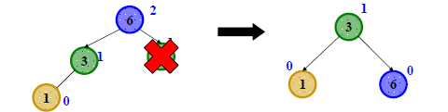
AVL Tree Deletion
Similar to insertion: do the delete and then rebalance
– Rotations and double rotations
– Imbalance may propagate upward so rotations at multiple nodes along path to root may be needed (unlike with insert)
Simple example: a deletion on the right causes the left-left grandchild
to be too tall

Slide 17
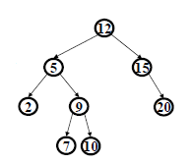
Properties of BST delete
We first do the normal BST deletion:
– 0 children: just delete it
– 1 child: delete it, connect child to parent
– 2 children: put successor in your place, delete successor leaf
Which nodes’ heights may have changed:
– 0 children: path from deleted node to root
– 1 child: path from deleted node to root
– 2 children: path from deleted successor leaf to root
Will rebalance as we return along the “path in question” to the root

Slide 18
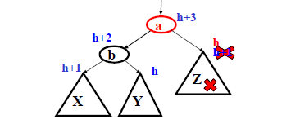
Case #1 Left-left due to right deletion
Start with some subtree where if right child becomes shorter we are
unbalanced due to height of left-left grandchild
A delete in the right child could cause this right-side shortening

Slide 19
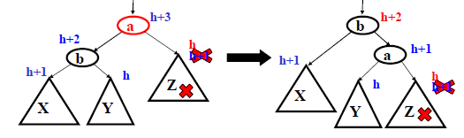
Case #1: Left-left due to right deletion
Same single rotation as when an insert in the left-left grandchild caused imbalance due to X becoming taller
• But here the “height” at the top decreases, so more rebalancing farther up the tree might still be necessary

Slide 20
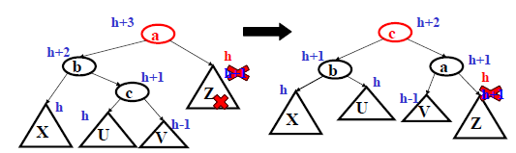
Case #2: Left-right due to right deletion
Same double rotation when an insert in the left-right grandchild caused imbalance due to c becoming taller
• But here the “height” at the top decreases, so more rebalancing farther up the tree might still be necessary

Slide 21
AVL Tree Deletion
Naturally there are two mirror-image cases not shown here
– Deletion in left causes right-right grandchild to be too tall
– Deletion in left causes right-left grandchild to be too tall

